Slide 1
2024 PHM Conference Tutorial
Probabilistic Deep Learning
Dr. Jesse Williams
GTC Analytics, CTO/VP of Digital Engineering
jwilliams@gtcanalytics.com
Actionable Intelligence through Analytics

Slide 2
Tutorial Overview
About me
Multi-model machine learning
Multi-model deep learning
Maskensemble deep learning
Application to the 2024 Data Challenge
Extra: TensorFlow Probability

Slide 3
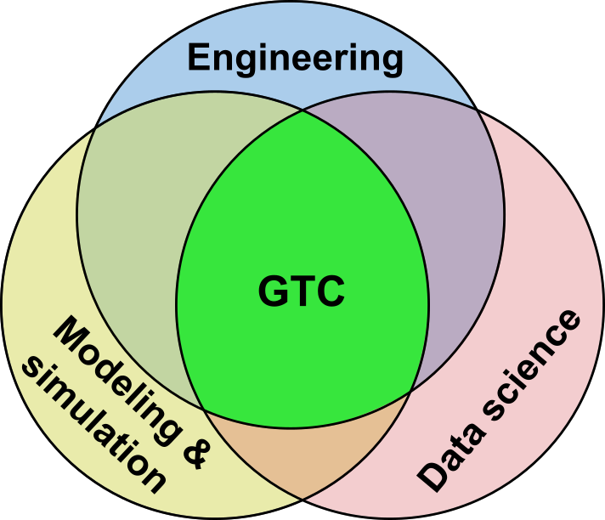
About Me
GTC Analytics
CTO / VP of Digital Engineering
LIM Innovations
CTO / VP of Engineering
National Institute for Materials Science (Japan)
Lead scientist
UC Santa Barbara
PHD, Material Engineering
Los Alamos National Laboratory
Undergraduate researcher

Slide 4
Probabilistic Estimation of Seismic Response Using Physics-Informed Recurrent Neural Networks
Idaho National Laboratory
Georgia Tech
Deep Learning Probabilistic Regression for Onset Time Determination
AFTAC
Stanford
SIREN: Seismic & Infrasound Intelligence for Rocket-Launch Event Notification
US Space Force
Machine Intelligence for Nuclear Explosion Monitoring
Applied Research Associates
Machine Learning Methods to Catalog Source from Diverse, Widely Distributed Sensor
AFRL
Georgia Tech
RaNDL: Rapid Nuclear and seismic events Discriminator and Locator
AFRL
Georgia Tech
MobiQkRad – Real Time Source Localization with Contextual Information
DHS
Decentralized Data Fusion Algorithm for Multisensor Radiation Source Search
DTRA
Oak Ridge National Laboratory
Model-Based Enterprise Architecture for Institutional Management Digital Twins
NASA
Georgia Tech
Enabling Digital Metrology and Manufacturing Through the Model-Based Enterprise
NAVAIR
University of Georgia
Digital Twin Technologies to Improve Mission Readiness and Sustainment
NAVAIR
Vanderbilt
ARADISS: Adaptive Real-time Anomaly Detection & Identification for Space Systems
NASA
University of Colorado, Boulder
Real Time Cybersecurity Systems for Safety Critical Military Vehicle Applications
US Army
University of Michigan
TRAIT: Transition-pipeline Recommender & Attrition Identification Tool
NAVAIR
Georgia Tech
US Navy Postgraduation School
Advanced Analysis of Nuclear Waste Storage Cask Health
Virginia Tech
TRACAIR: TRAjectory Course analyzer and Anomaly IdentifieR
NASA
Georgia Tech
Seismic AI in RealTime for Informed Drilling and Fracking
DOE
Georgia Tech
Operation-Aware ISHM for Environmental Control and Life Support in Deep Space Habitants
NASA
University of South Carolina
Resource Management Strategies for a Resilient Habitat Advanced Life Support (ALS) System
NASA
Georgia Tech

Slide 5
Probabilistic DL Basic Concepts
Ensemble method
Many models each with their own
History/beliefs
When inference is “easy”
Models predict similar estimation
When inference is “hard”
Model predictions diverge
Inference confidence can be correlated to
Predict standard distribution

Slide 6
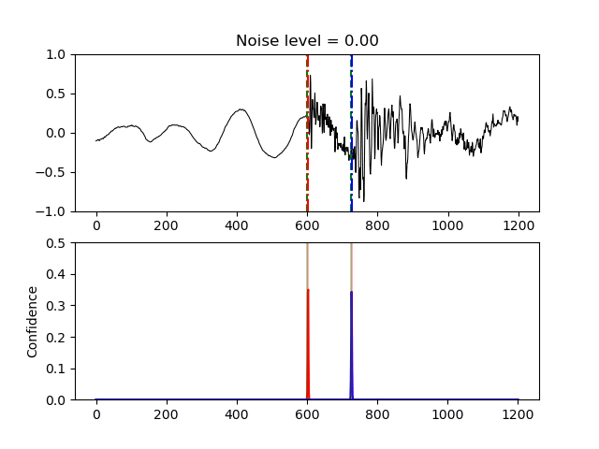
Probabilistic DL Basic Concepts

Slide 7
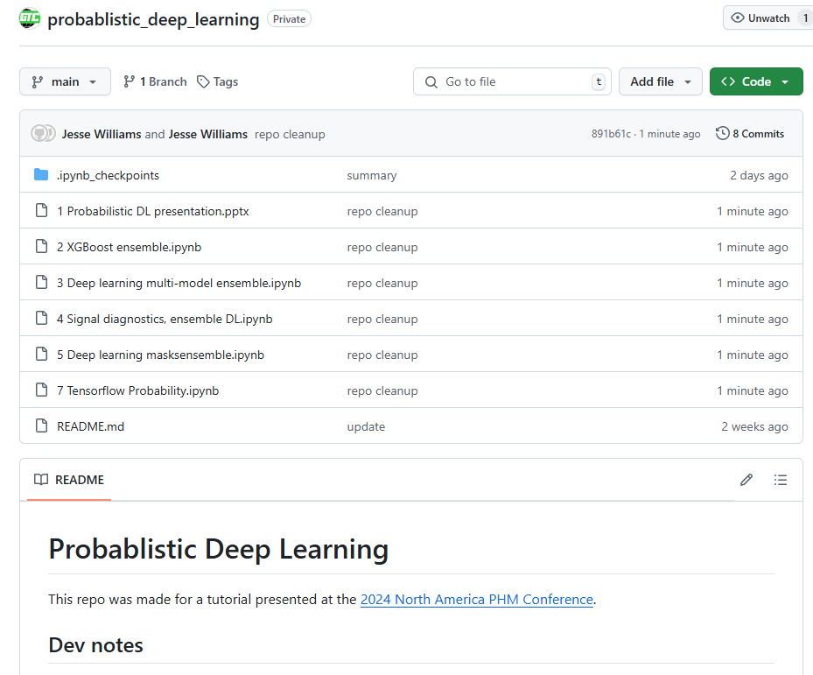

Tutorial Resources
https://github.com/globaltechinc/probablistic_deep_learning

Slide 8
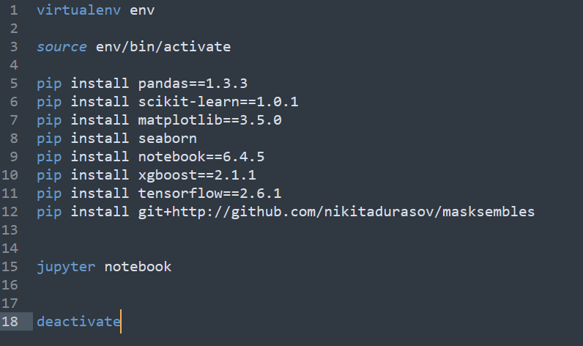
Environment Setup

Slide 9
Multi-model Machine Learning
Notebook: 2 XGBoost ensemble

Slide 10
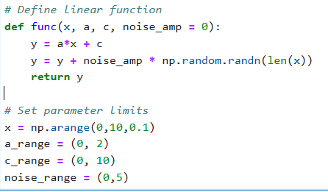
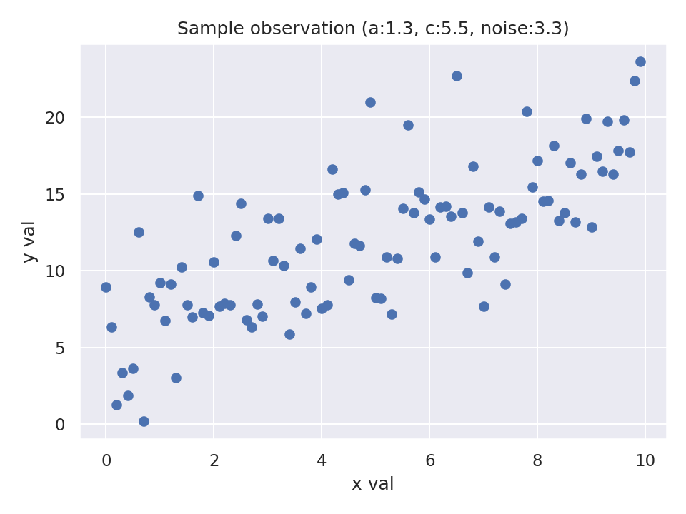
Multi-model Machine Learning: RUL Est.
Create the dataset generator

Slide 11
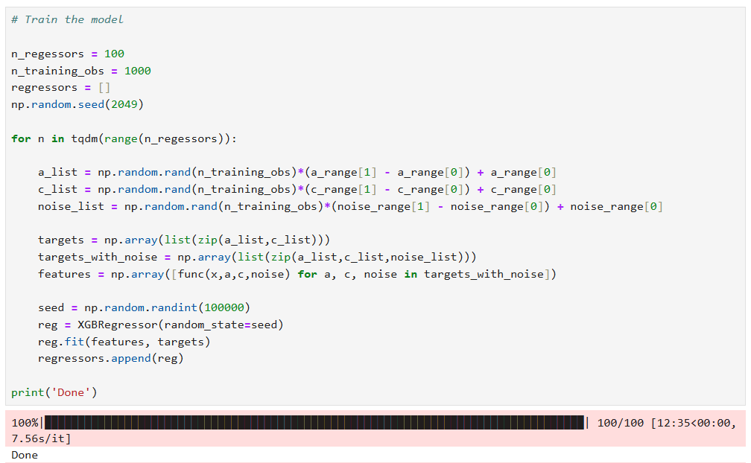
Multi-model Machine Learning: RUL Est.
Train an ensemble of models

Slide 12
Multi-model Machine Learning: RUL Est.
Train an ensemble of models
Setup

Slide 13
Multi-model Machine Learning: RUL Est.
Train an ensemble of models
Looping with visibility

Slide 14
Multi-model Machine Learning: RUL Est.
Train an ensemble of models
For each model
Create a unique training dataset

Slide 15
Multi-model Machine Learning: RUL Est.
Train an ensemble of models
For each model
Define features and targets

Slide 16
Multi-model Machine Learning: RUL Est.
Train an ensemble of models
For each model
Define features and targets

Slide 17
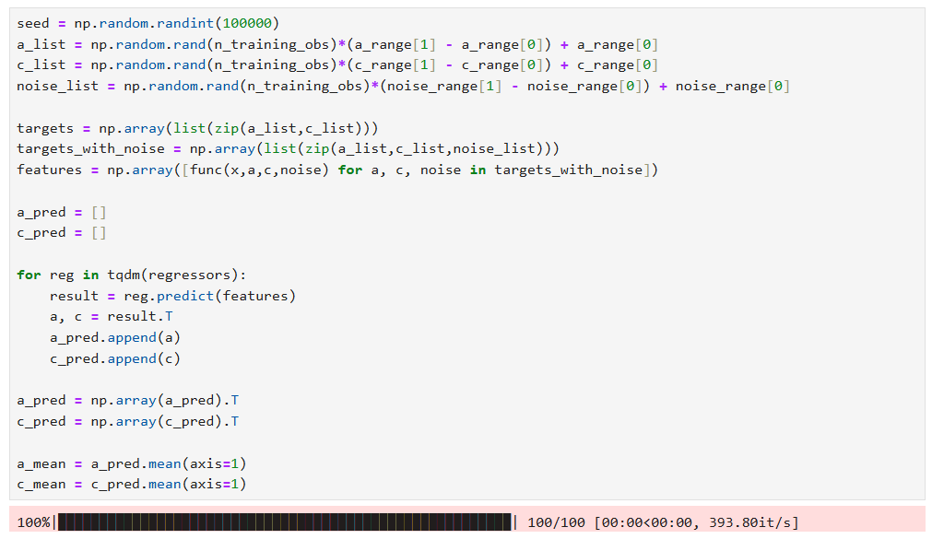
Multi-model Machine Learning: RUL Est.
Test an ensemble of models

Slide 18
Multi-model Machine Learning: RUL Est.
Test an ensemble of models
Build new dataset

Slide 19
Multi-model Machine Learning: RUL Est.
Test an ensemble of models
Each model performs inference

Slide 20
Multi-model Machine Learning: RUL Est.
Test an ensemble of models
Evaluate inference statistics

Slide 21
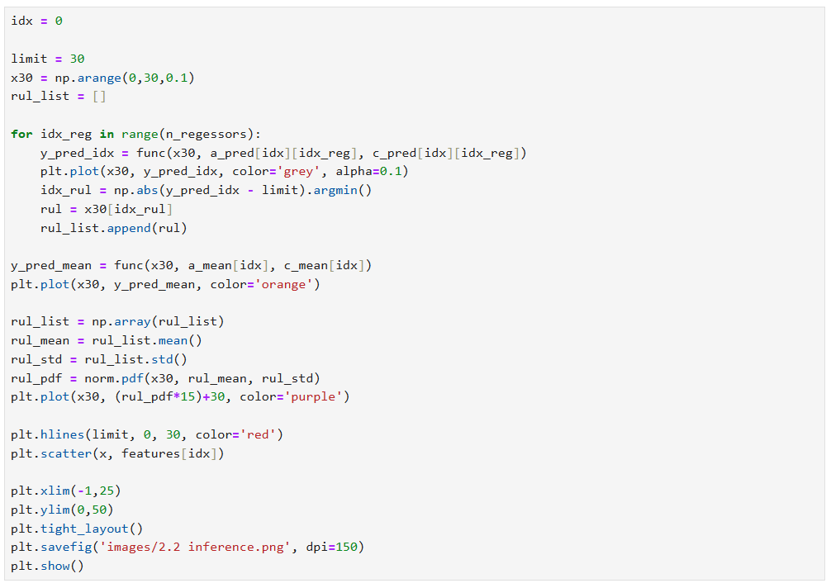
Multi-model Machine Learning: RUL Est.
Sample test inference

Slide 22
Multi-model Machine Learning: RUL Est.
Sample test inference
Consider RUL to x=30
Individual model pred.
Predicted mean
Normal PDF of all RULs

Slide 23
Multi-model Machine Learning: RUL Est.
Sample test inference
Consider RUL to x=30
Individual model pred.
Predicted mean
Normal PDF of all RULs

Slide 24
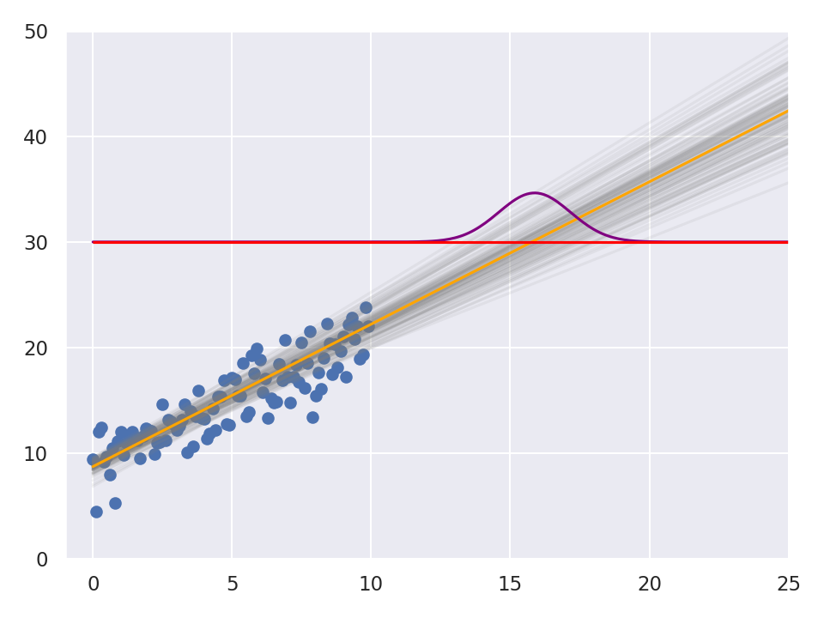
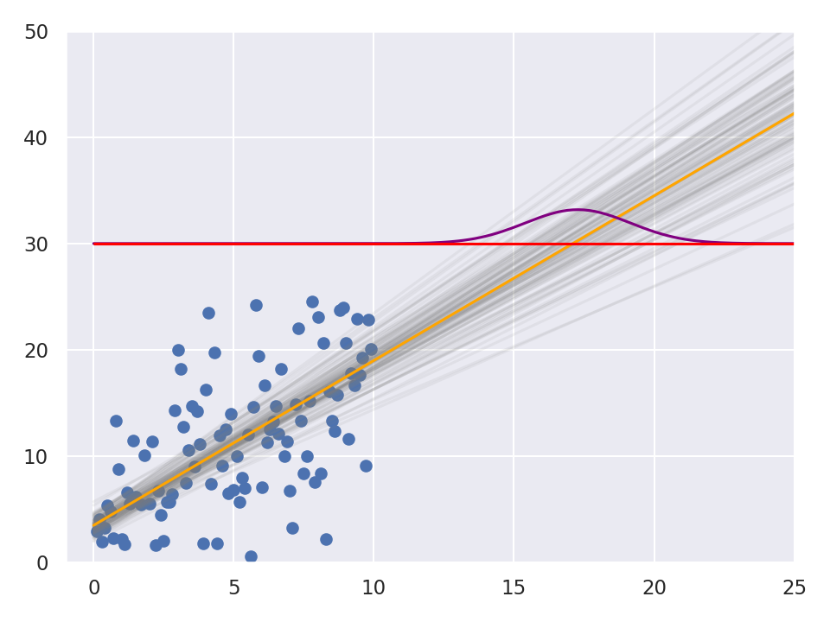
Multi-model Machine Learning: RUL Est.
Sample test inference

Slide 25
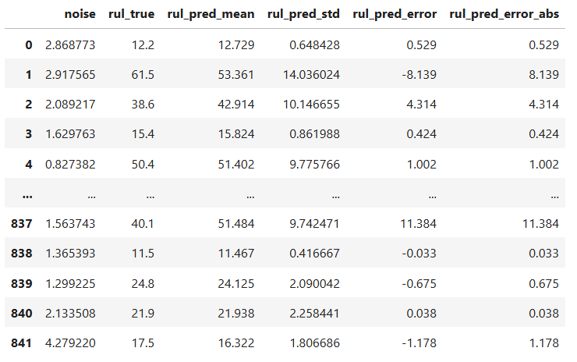
Multi-model Machine Learning: RUL Est.
Correlating predicted STD to error

Slide 26
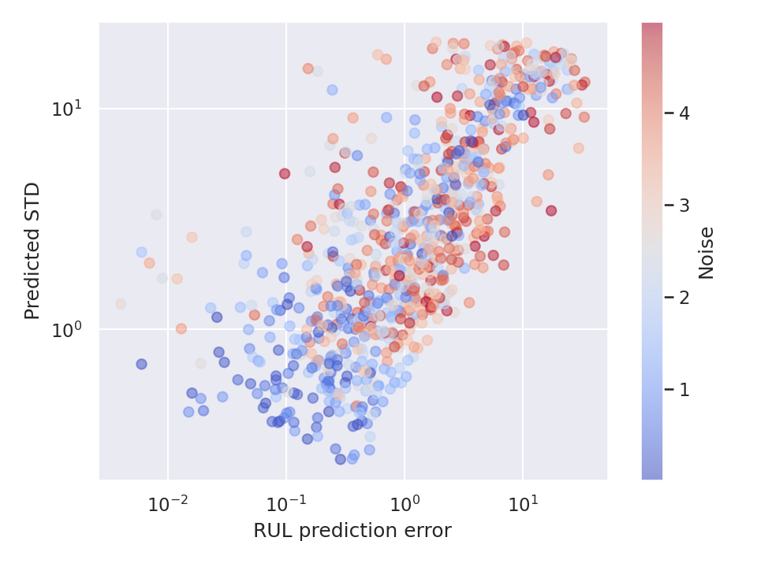
Multi-model Machine Learning: RUL Est.
Correlating predicted STD to error

Slide 27
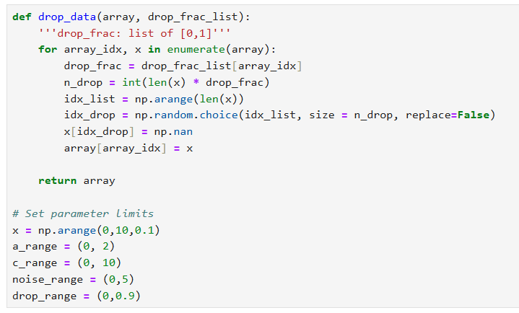
Multi-model Machine Learning: RUL Est.
Working with dropped or missing data

Slide 28
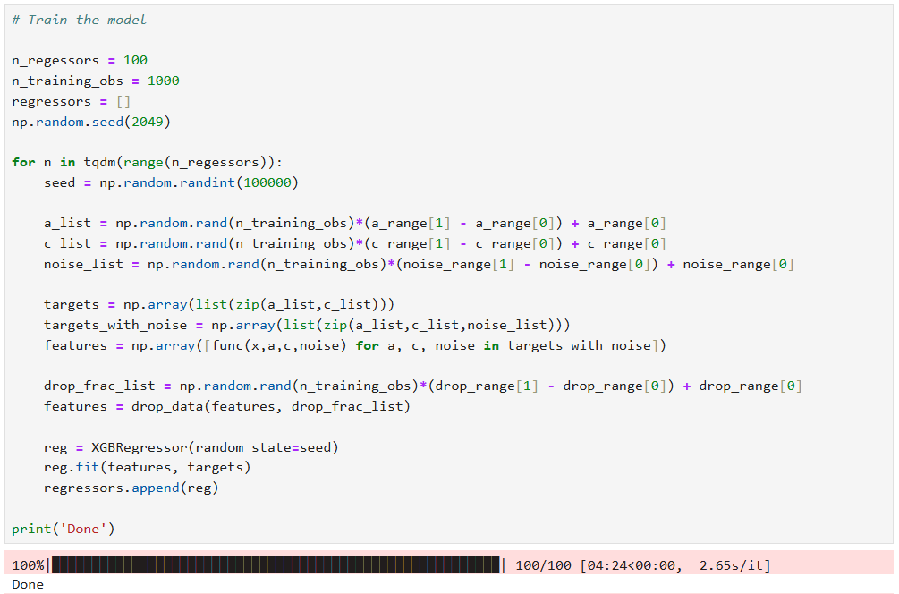
Multi-model Machine Learning: RUL Est.
Working with dropped or missing data
Drop data in the features

Slide 29
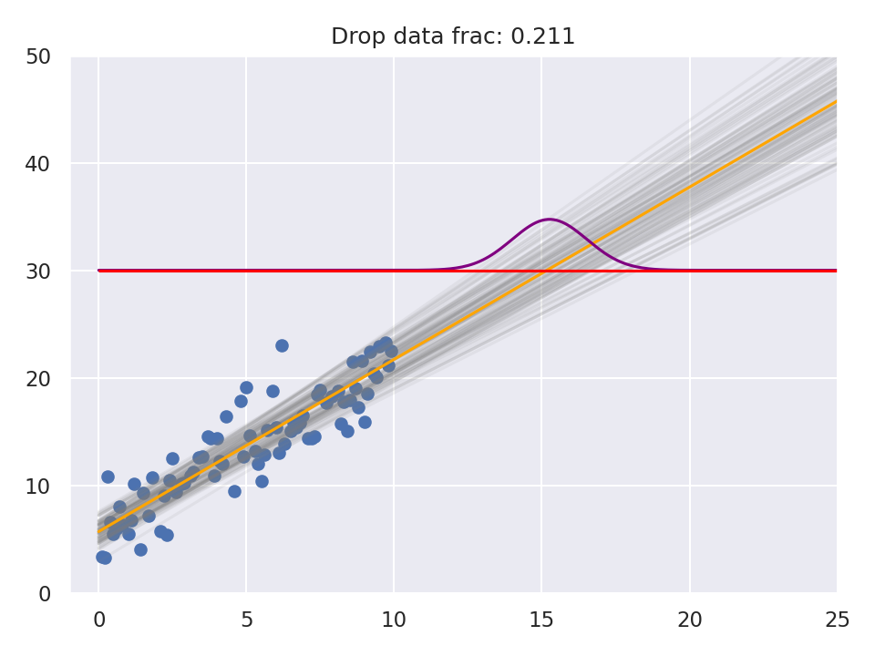
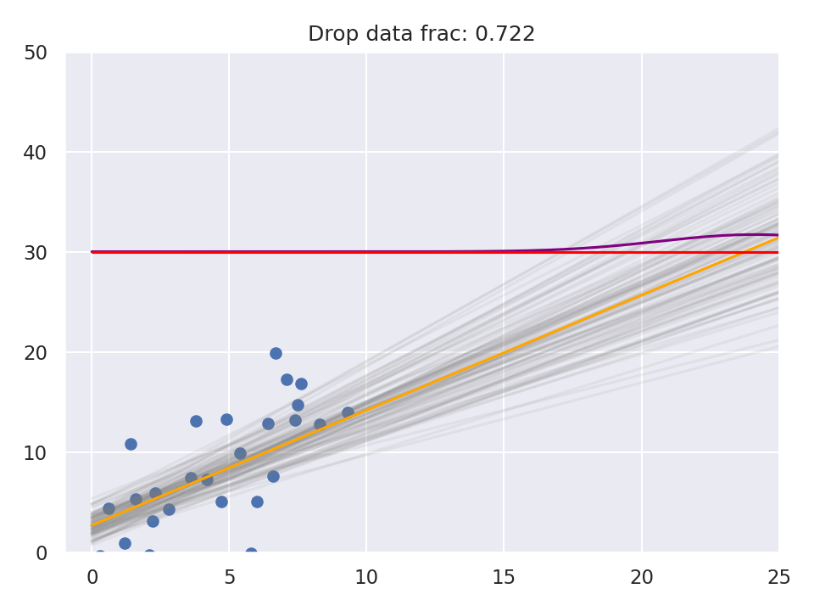
Multi-model Machine Learning: RUL Est.
Working with dropped or missing data

Slide 30
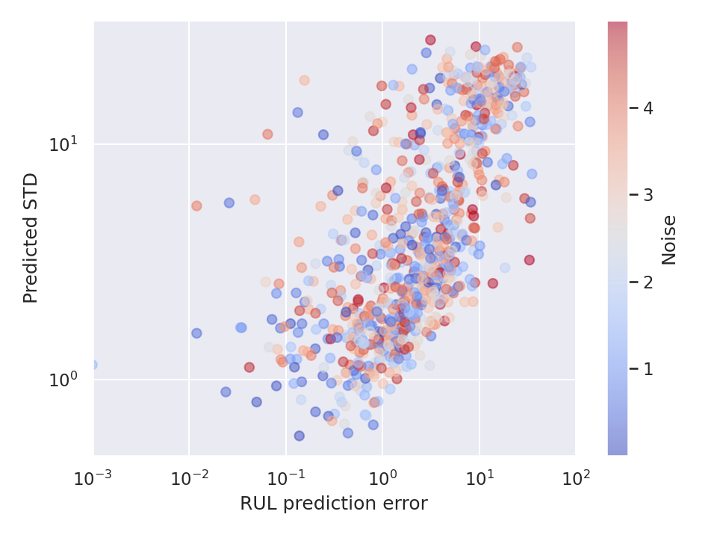
Multi-model Machine Learning: RUL Est.
Working with dropped or missing data

Slide 31
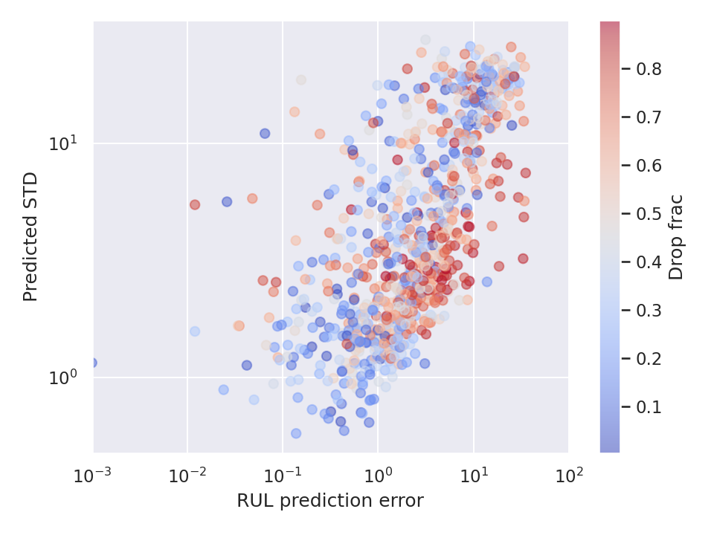
Multi-model Machine Learning: RUL Est.
Working with dropped or missing data

Slide 32
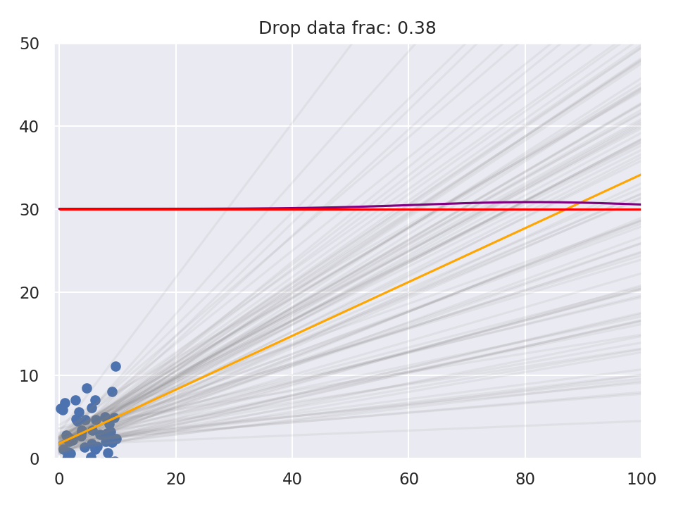
Multi-model Machine Learning: RUL Est.
Working with dropped or missing data

Slide 33
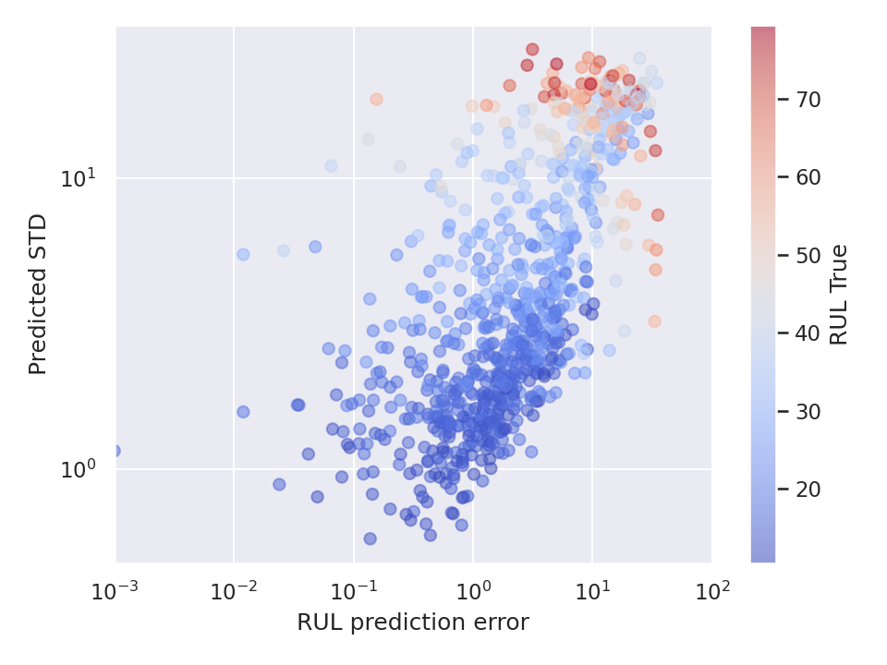
Multi-model Machine Learning: RUL Est.
Working with dropped or missing data

Slide 34
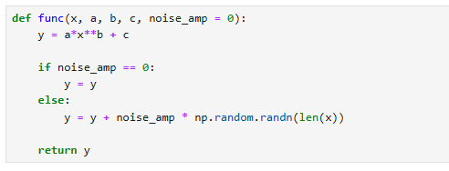
Multi-model Machine Learning: RUL Est.
Non-linear RUL

Slide 35
Multi-model Machine Learning: RUL Est.
Non-linear RUL

Slide 36
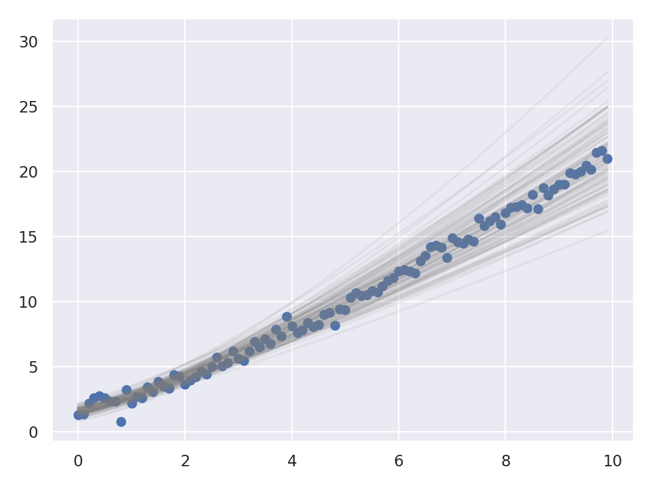
Multi-model Machine Learning: RUL Est.
Non-linear RUL

Slide 37
Multi-model Machine Learning: RUL Est.
XGBoost Recap
Multi-variable regression with XGBoost
Train multiple models
Unique data for each model-training set (unique experience)
Dropped/missing data is okay
Non-linear functions are okay

Slide 38
Multi-model Deep Learning
Notebook: 3 Deep learning multi-model ensemble

Slide 39
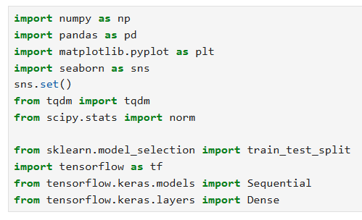
Multi-model Deep Learning: RUL Est.
Examples will be with TensorFlow

Slide 40
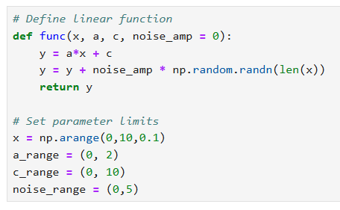
Multi-model Deep Learning: RUL Est.
Same linear RUL example

Slide 41
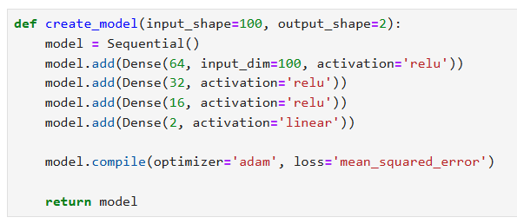
Multi-model Deep Learning: RUL Est.
Create basic dense MLP

Slide 42
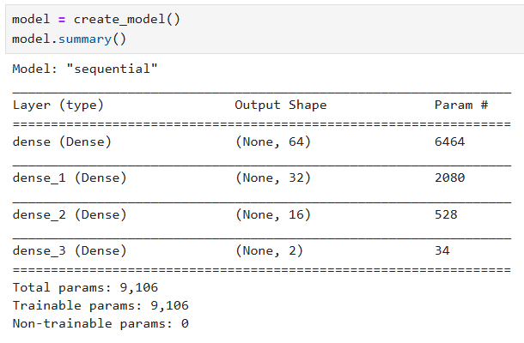
Multi-model Deep Learning: RUL Est.
Create basic dense MLP

Slide 43
Multi-model Deep Learning: RUL Est.
Create basic dense MLP

Slide 44
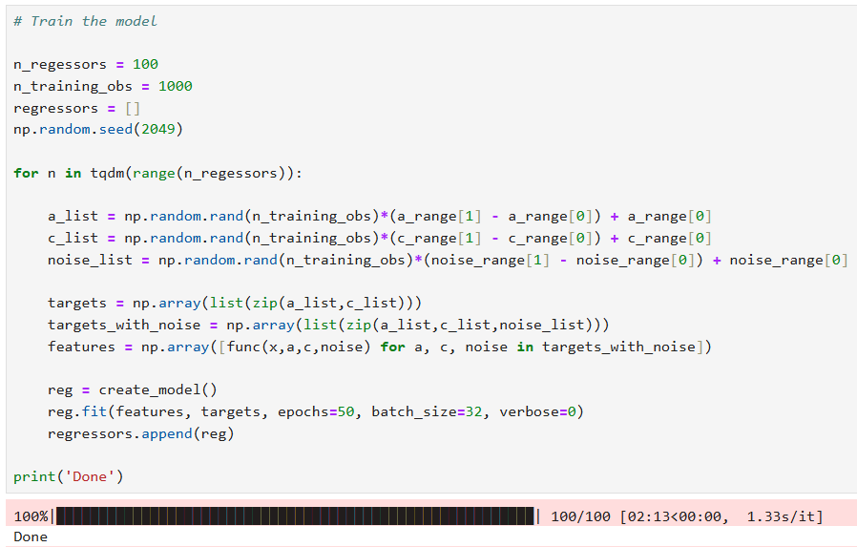
Multi-model Deep Learning: RUL Est.
Train an ensemble of models

Slide 45
Multi-model Deep Learning: RUL Est.
Train an ensemble of models
Update from previous code

Slide 46
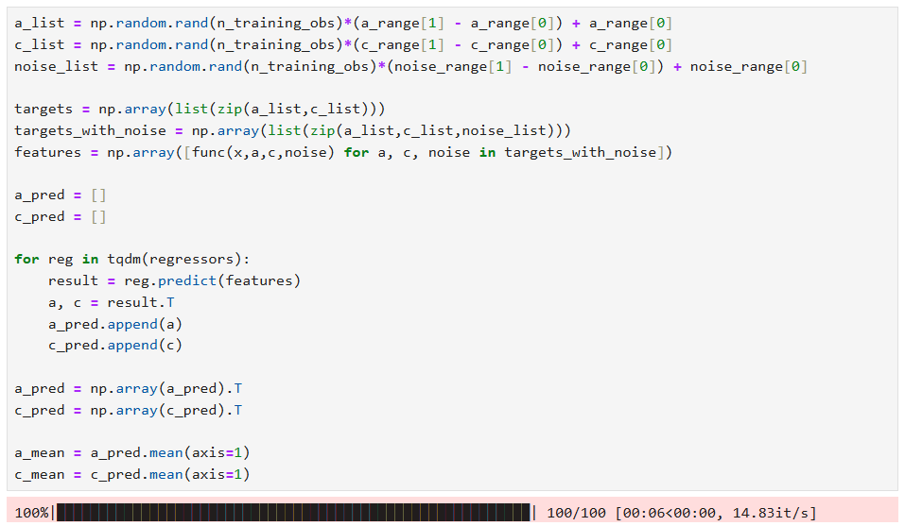
Multi-model Deep Learning: RUL Est.
Test an ensemble of models
Code unchanged from previous example

Slide 47
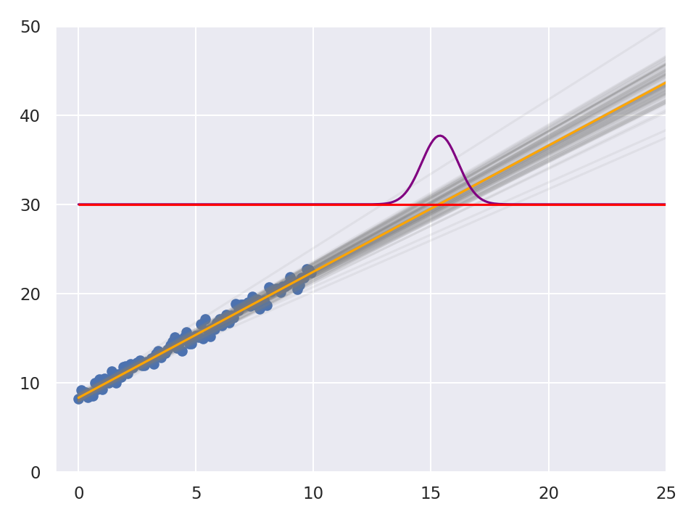
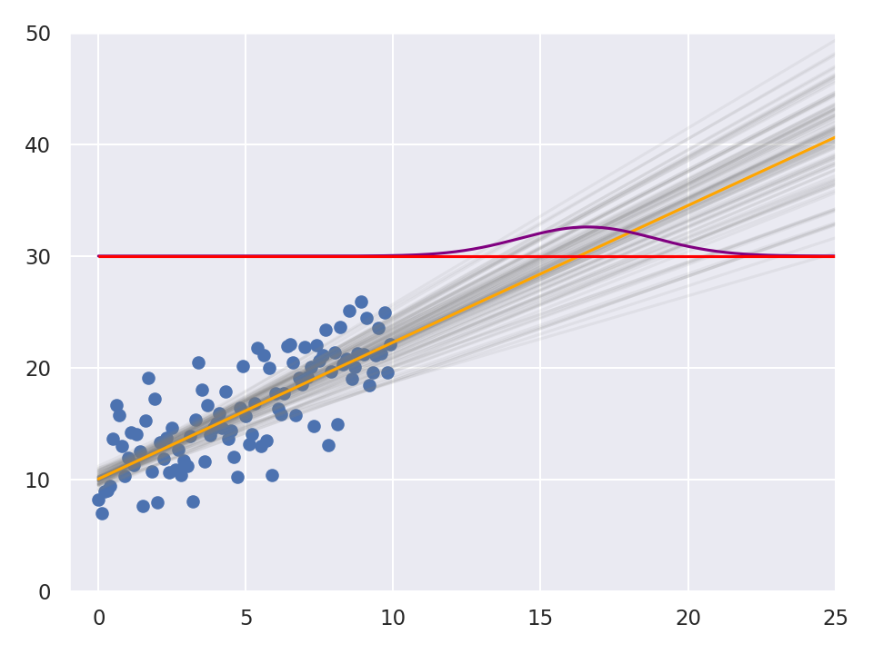
Multi-model Deep Learning: RUL Est.
Test an ensemble of models

Slide 48
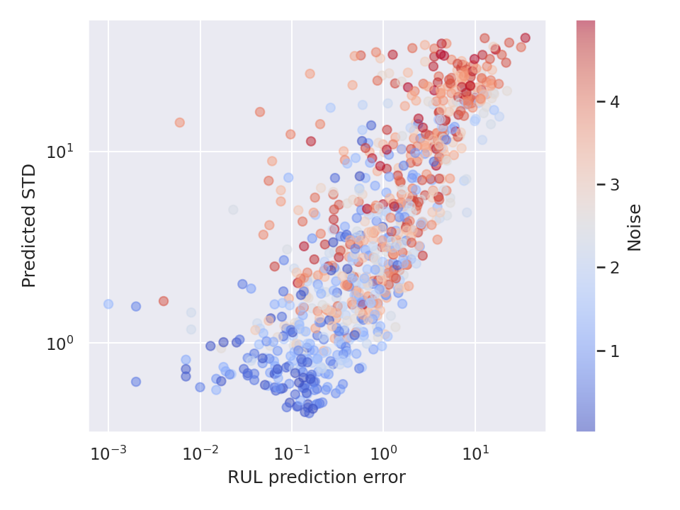
Multi-model Deep Learning: RUL Est.
Correlating predicted STD to error

Slide 49
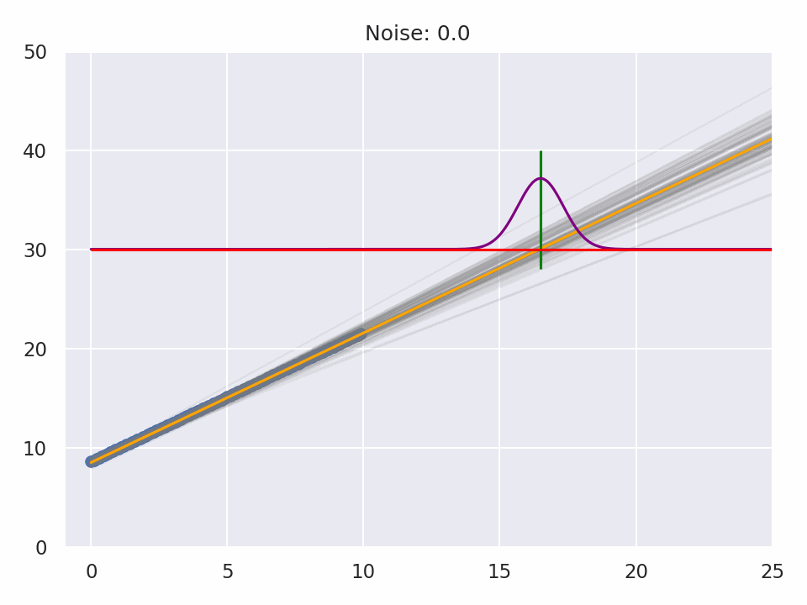
Multi-model Deep Learning: RUL Est.
Visualizing predicted STD to error

Slide 50
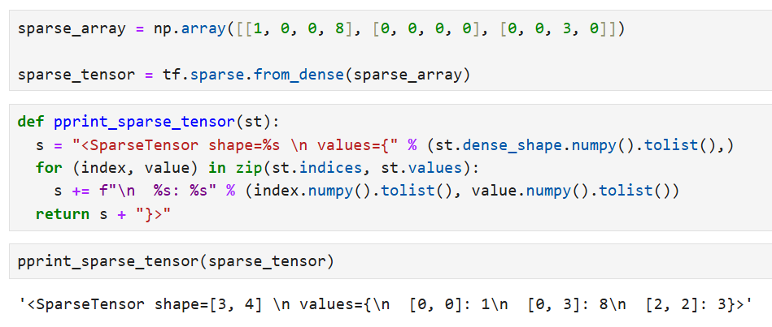
Multi-model Deep Learning: RUL Est.
Handling dropped/missing data
Option 1: Use a sparse tensor

Slide 51
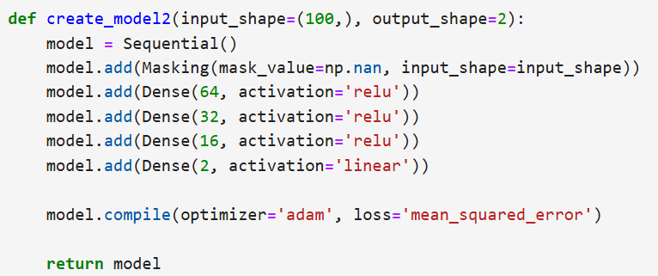
Multi-model Deep Learning: RUL Est.
Handling dropped/missing data
Option 2: Use a mask layer during input

Slide 52
Multi-model Deep Learning
Health diagnostics: Classification
Notebook: 4 Signal diagnostics, ensemble DL

Slide 53
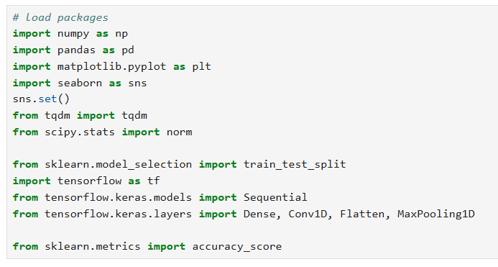
Multi-model Deep Learning: Diagnostics
New packages
1D CNNs for direct signal processing

Slide 54
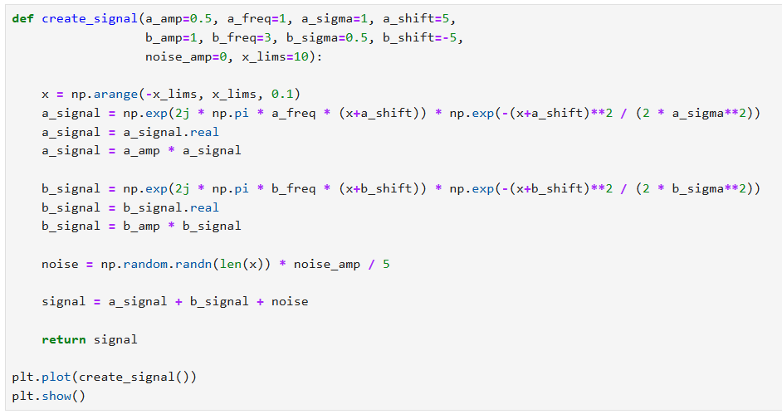
Multi-model Deep Learning: Diagnostics
Problem statement / data generator

Slide 55
Multi-model Deep Learning: Diagnostics
Problem statement / data generator
X sequence
a-type signal
b-type signal
Add noise
Aggregate signal

Slide 56
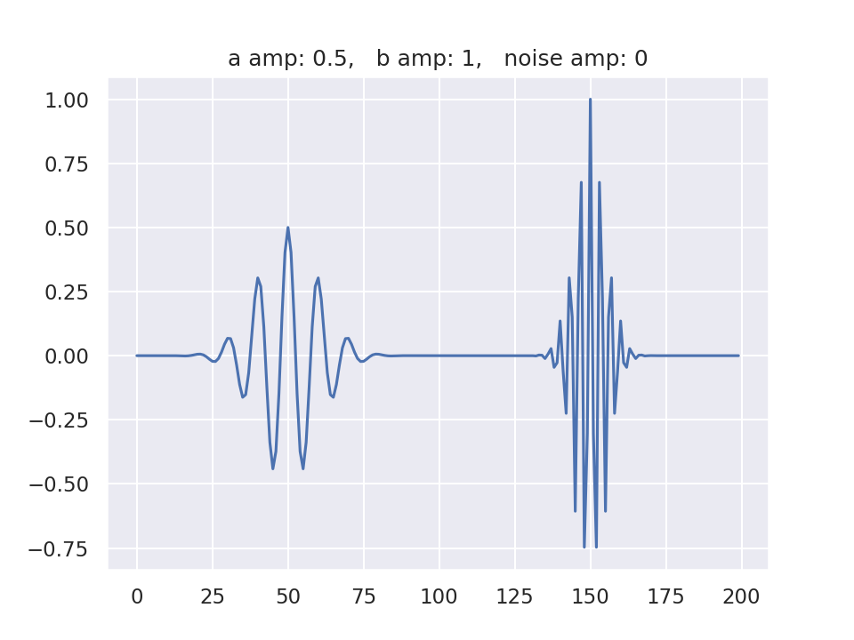
Multi-model Deep Learning: Diagnostics
Problem statement / data generator

Slide 57
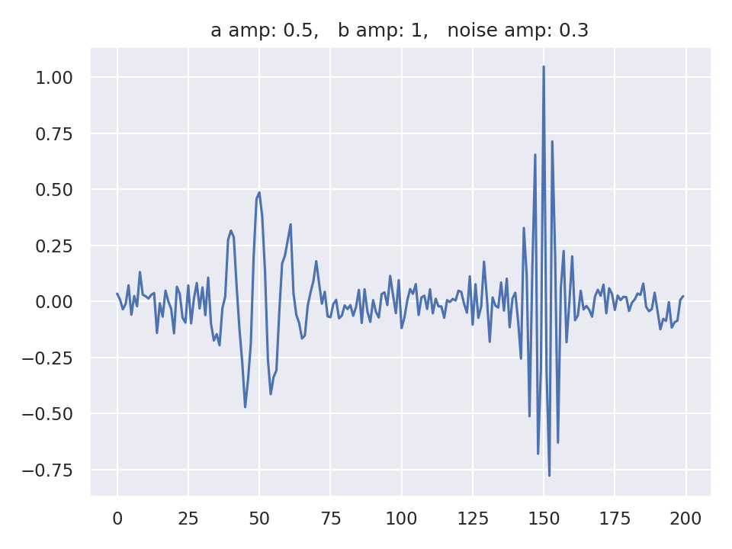
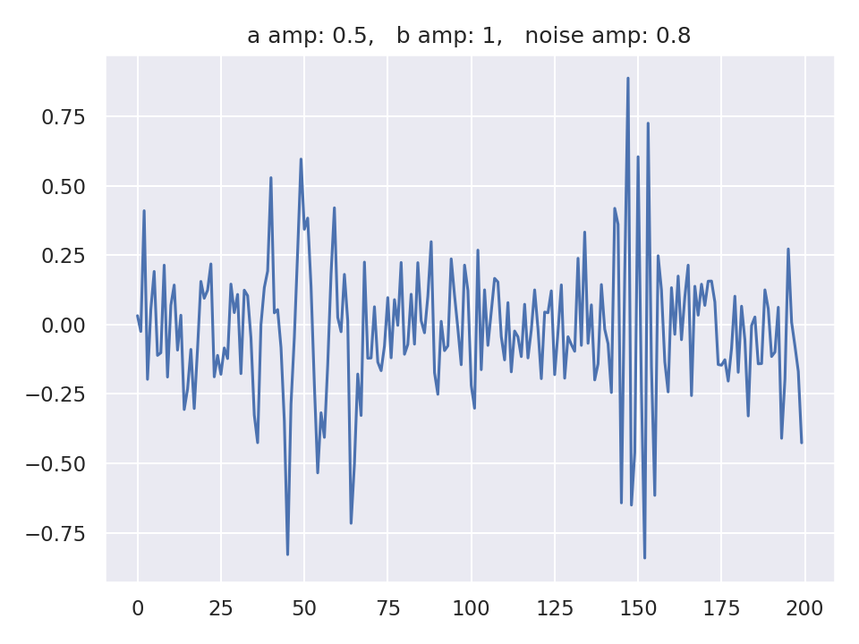
Multi-model Deep Learning: Diagnostics
Problem statement / data generator

Slide 58
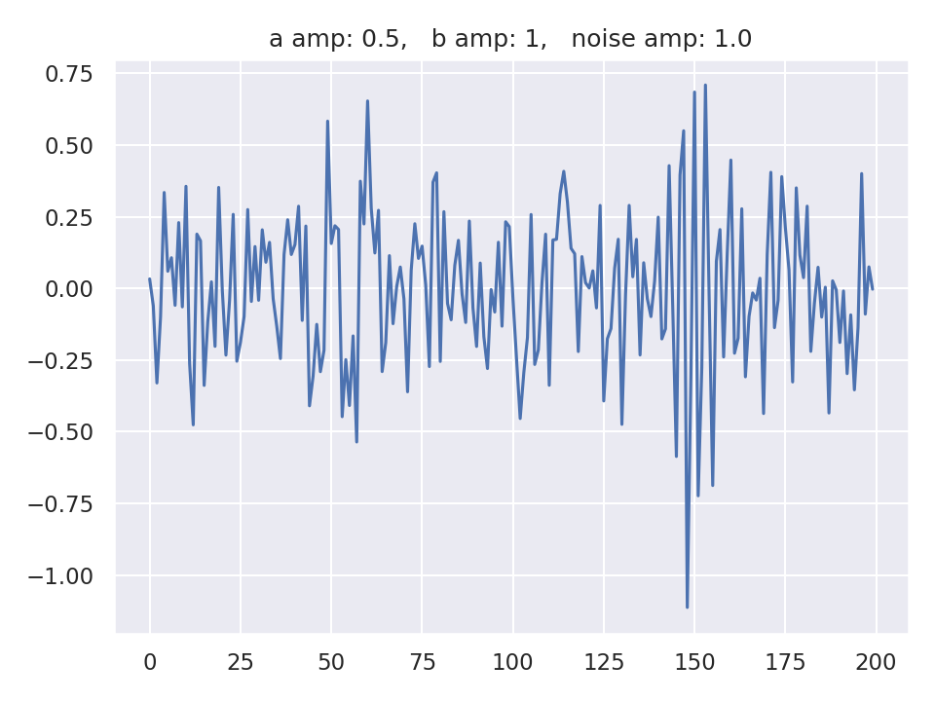
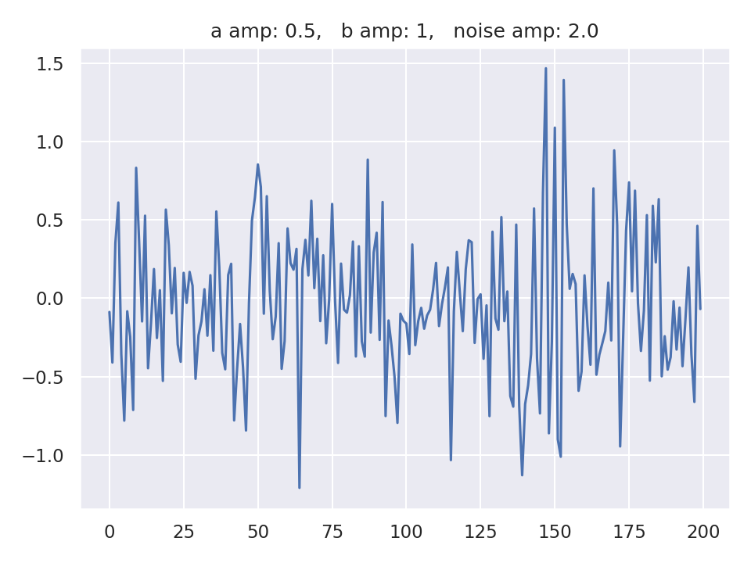
Multi-model Deep Learning: Diagnostics
Problem statement / data generator

Slide 59
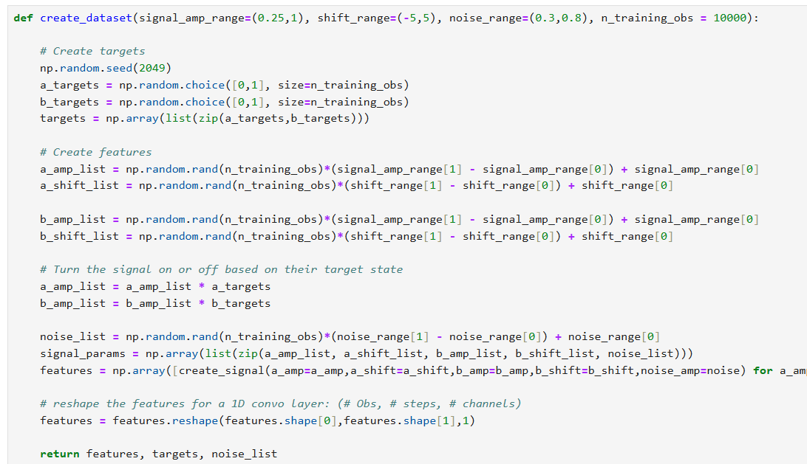
Multi-model Deep Learning: Diagnostics
Problem statement / data generator

Slide 60
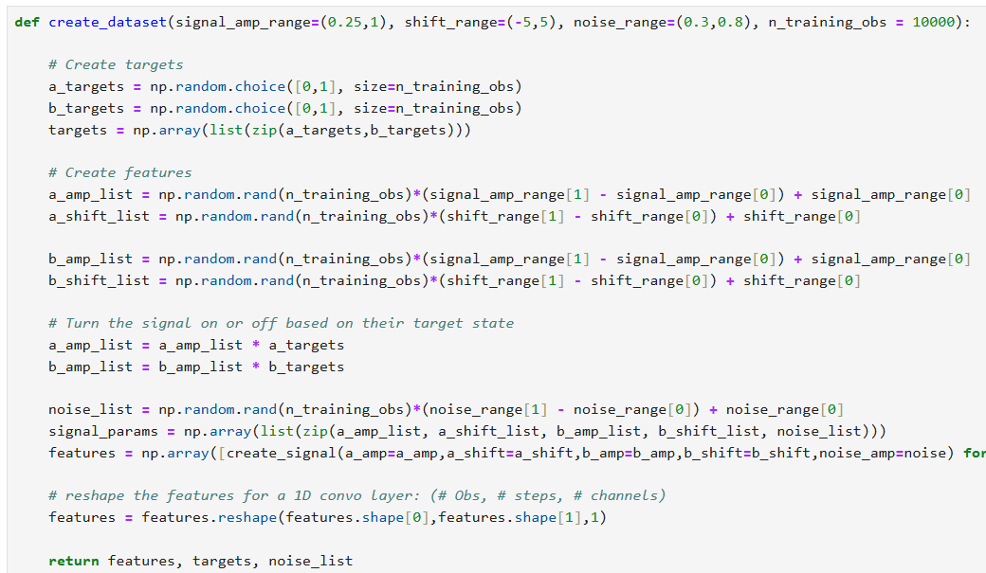
Multi-model Deep Learning: Diagnostics
Problem statement / data generator
Define which signals are present
a-signal parameters
b-signal parameters
Turn signals on/off
Produce feature signals

Slide 61
Multi-model Deep Learning: Diagnostics
Problem statement / data generator
Reshape the input vector

Slide 62
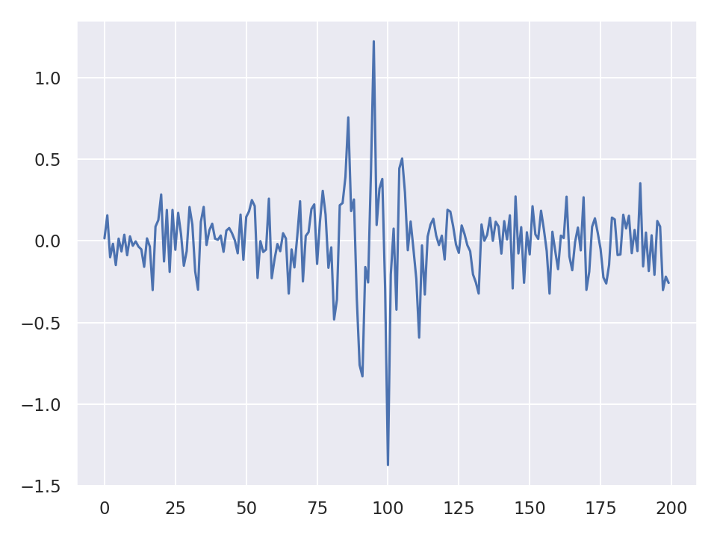
Multi-model Deep Learning: Diagnostics
Problem statement / data generator

Slide 63
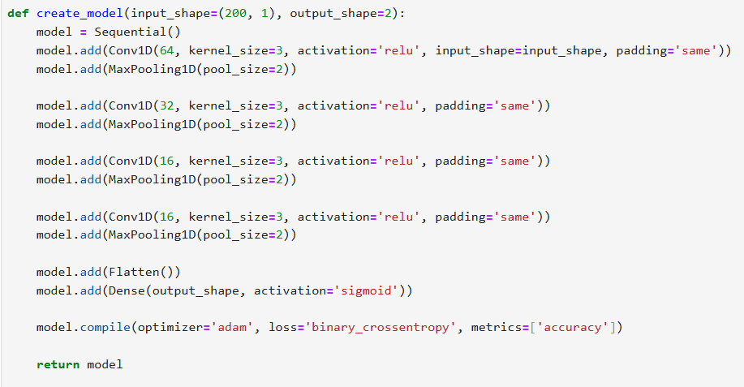
Multi-model Deep Learning: Diagnostics
Deep learning model architecture

Slide 64
Multi-model Deep Learning: Diagnostics
Deep learning model architecture
Vanilla CNN
Sigmoid
Binary cross-entropy

Slide 65
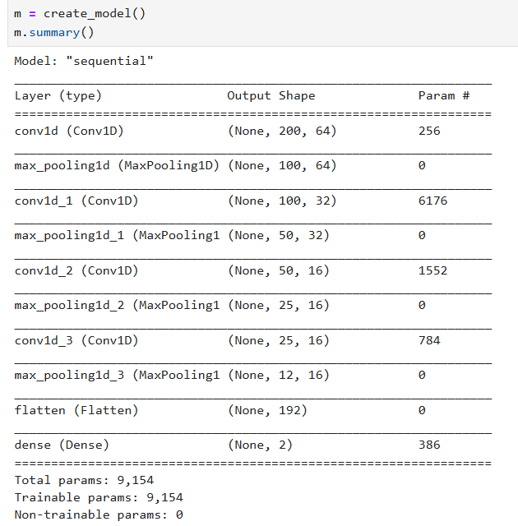
Multi-model Deep Learning: Diagnostics
Deep learning model architecture

Slide 66
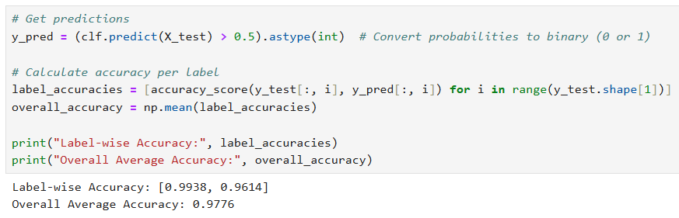
Multi-model Deep Learning: Diagnostics
Single model performance

Slide 67
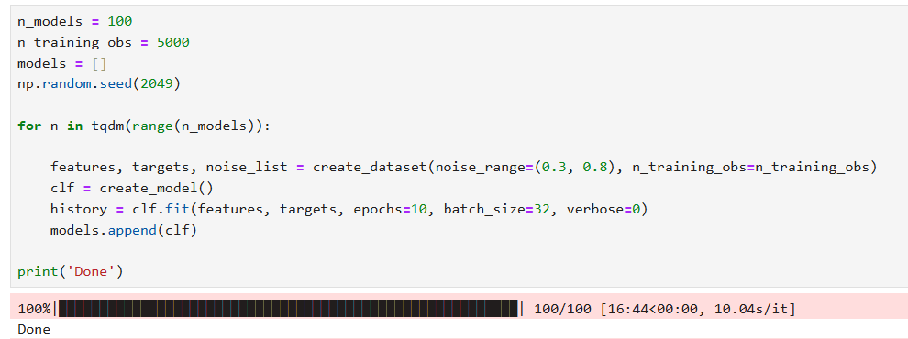
Multi-model Deep Learning: Diagnostics
Train an ensemble of models

Slide 68
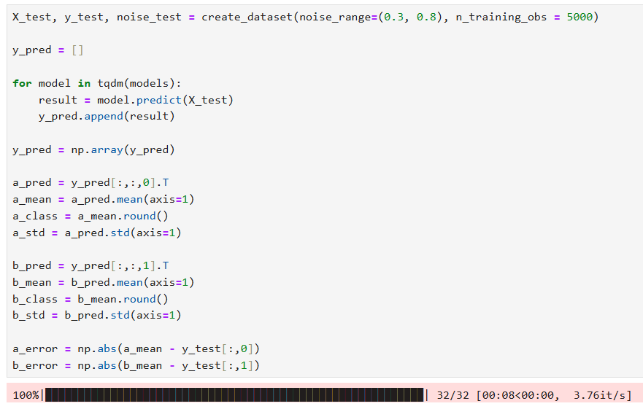
Multi-model Deep Learning: Diagnostics
Test an ensemble of models

Slide 69
Multi-model Deep Learning: Diagnostics
Test an ensemble of models
a-signal stats
b-signal stats
error

Slide 70

Multi-model Deep Learning: Diagnostics
Test an ensemble of models

Slide 71
Masksemble Deep Learning
Notebook: 5 Deep learning masksensemble

Slide 72


About maskensmble
https://github.com/nikitadurasov/masksembles

Slide 73
About maskensmble
Predictive uncertainty in Deep Learning
Batch Ensembling
1.05
0.98
1.02
1.016 ± 0.028

Slide 74
About maskensmble
Predictive uncertainty in Deep Learning
Batch Ensembling
Monte-Carlo DropOut
1.05
0.98
1.02
1.05
0.98
1.02
1.016 ± 0.028
1.016 ± 0.028

Slide 75

About maskensmble
Predictive uncertainty in Deep Learning
Batch Ensembling
Monte-Carlo DropOut

Slide 76

About maskensmble
Input

Slide 77
About maskensmble
Input
Batched Copies

Slide 78
About maskensmble
Neural Network with Masksemble layers (Subnetworks)
Input
Batched Copies

Slide 79
About maskensmble
Subnetwork 1
Subnetwork 2
Subnetwork 3
Subnetwork 4
Input
Batched Copies
Neural Network with Masksemble layers (Subnetworks)

Slide 80
About maskensmble
Subnetwork 1
(0.52, 0.63)
Subnetwork 2
(0.47, 0.61)
Subnetwork 3
(0.53, 0.65)
Subnetwork 4
(0.55, 0.58)
Input
Batched Copies
Neural Network with Masksemble layers (Subnetworks)

Slide 81

About maskensmble
Subnetwork 1
(0.52, 0.63)
a-mean
c-mean
Subnetwork 2
(0.47, 0.61)
Subnetwork 3
(0.53, 0.65)
Variance
Subnetwork 4
(0.55, 0.58)
Input
Batched Copies
Neural Network with Masksemble layers (Subnetworks)
Model’s confidence in the pick

Slide 82



About maskensmble

Slide 83
Maskensmbles basics

Slide 84

Maskensmbles: RUL Estimation

Slide 85

Maskensmbles: RUL Estimation

Slide 86

Maskensmbles: RUL Estimation
Create DL model with maskensembles layers

Slide 87
Maskensmbles: RUL Estimation
Create DL model with maskensembles layers

Slide 88
Maskensmbles: RUL Estimation
Create DL model with maskensembles layers
Number masks
Mask coherence

Slide 89

Maskensmbles: RUL Estimation
Create DL model with maskensembles layers

Slide 90
Maskensmbles: RUL Estimation
Maskensembles considerations
Each mask is linked to a batch position

Slide 91
Maskensmbles: RUL Estimation
Maskensembles considerations
Each mask is linked to a batch position
Batch
Input vector 1
Input vector 2
Input vector 3
Masking layer

Slide 92
Maskensmbles: RUL Estimation
Maskensembles considerations
Each mask is linked to a batch position
Batch
Input vector 1
Input vector 2
Input vector 3
Batch
Input vector 1
Input vector 2
Input vector 3
Batch
Input vector 1
Input vector 2
Input vector 3
Batch
Input vector 1
Input vector 2
Input vector 3

Slide 93
Maskensmbles: RUL Estimation
Maskensembles considerations
Each mask is linked to a batch position
Mask size must equal batch size
During training and inference
Batch size (and mask size) are also the number of “independent” models
When training, training dataset size must be divisible by the batch size

Slide 94

Maskensmbles: RUL Estimation
Training DL maskensembles model

Slide 95

Maskensmbles: RUL Estimation
Testing DL maskensembles model

Slide 96

Maskensmbles: RUL Estimation
Testing DL maskensembles model

Slide 97
Maskensmbles: RUL Estimation
Testing DL maskensembles model
10,000,000 predictions = 10,000 repeated 100 times

Slide 98

Maskensmbles: RUL Estimation
Testing DL maskensembles model
Reshape the pred data for statistical analysis

Slide 99

Maskensmbles: RUL Estimation
Testing DL maskensembles model

Slide 100

Maskensmbles: RUL Estimation
Testing DL maskensembles model

Slide 101
Maskensmbles: RUL Estimation
Create DL model with maskensembles layers

Slide 102

Maskensmbles: RUL Estimation
Improving the model
Bigger training dataset
Bigger model
Longer training

Slide 103

Maskensmbles: RUL Estimation
Improving the model
Old model
New model

Slide 104
Masksemble 2024 Data Challenge
Notebook: 6 PHM DC with masksembles

Slide 105


2024 PHM DC Competition
Helicopter Turboshaft Engine Health State estimation

Slide 106

2024 PHM DC Competition
Helicopter Turboshaft Engine Health State estimation

Slide 107

2024 PHM DC Competition
Data preparation

Slide 108


2024 PHM DC Competition
Data preparation

Slide 109
2024 PHM DC Competition
Data preparation
Features
Measured torque
Outside air temperature
Mean gas temperature
Power available
Indicated airspeed
Net power
Compressor speed (ng)
Targets
Torque margin (float)
torque margin (%) = 100 * (torque measured – torque target) / torque target

Slide 110

2024 PHM DC Competition
Data preparation
Split and shuffle the data for training and test
Scale the data for a balanced use of the data

Slide 111

2024 PHM DC Competition
Create DL model with maskensembles layers

Slide 112

2024 PHM DC Competition
Train the DL model with maskensebles
Make sure that the train dataset size is even divisible by the batch size

Slide 113


2024 PHM DC Competition
Train the DL model with masksensembles

Slide 114

2024 PHM DC Competition
Test the DL model with masksensembles

Slide 115


2024 PHM DC Competition
Test the DL model with masksensembles
Mean absolute error
Maximum absolute error

Slide 116

2024 PHM DC Competition

Slide 117

2024 PHM DC Competition

Slide 118

2024 PHM DC Competition

Slide 119

2024 PHM DC Competition

Slide 120
2024 PHM DC Competition

Slide 121
More on Training masksensembles
Each batch position should have a unique experience
If using a static training dataset
Don’t shuffle the data during training

Slide 122
More on Training masksensembles
Each batch position should have a unique experience
If using a static training dataset
Don’t shuffle the data during training
If possible Dynamically add variation to each training observation
Consider a data generator

Slide 123


More on Training masksensembles
https://www.tensorflow.org/guide/data
TensorFlow Data Generator

Slide 124
Final comments on using masksensembles
Unless there is a good reason
Always use it when building a DL regression model
It’s easy and there is significant value
Little value in classification applications
From my experience
Though may if properly constructed may perform slightly better than a deterministic model

Slide 125

Thanks
Actionable Intelligence through Analytics

Slide 126
Bonus TensorFlow Probability
Notebook: 7 TensorFlow Probability

Slide 127

Regression with TensorFlow Probability
https://www.tensorflow.org/probability/examples/Probabilistic_Layers_Regression

Slide 128

Regression with TensorFlow Probability
Import tfp distributions

Slide 129

Regression with TensorFlow Probability
Create a custom loss function

Slide 130

Regression with TensorFlow Probability
Build a model with distribution layers

Slide 131

Regression with TensorFlow Probability
Build a model with distribution layers

Slide 132

Regression with TensorFlow Probability
Capture aleatoric uncertainty

Slide 133

Regression with TensorFlow Probability
Capture aleatoric uncertainty

Slide 134

Regression with TensorFlow Probability
Capture epistemic uncertainty

Slide 135

Regression with TensorFlow Probability
Capture epistemic uncertainty

Slide 136

Regression with TensorFlow Probability
Capture epistemic uncertainty

Slide 137

Regression with TensorFlow Probability
Capture aleatoric and epistemic uncertainty

Slide 138

Regression with TensorFlow Probability
Capture aleatoric and epistemic uncertainty

